Slide 1



EAAA IR Course – Lecture one!

Slide 2
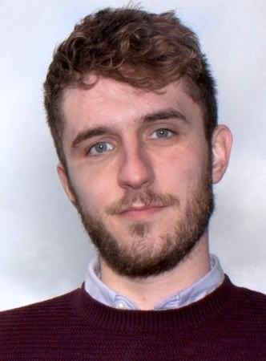

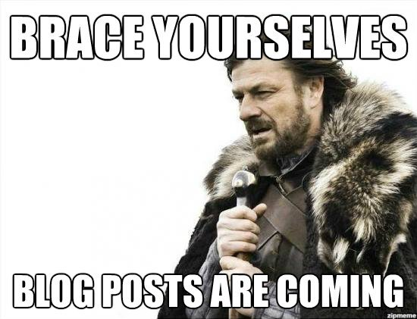

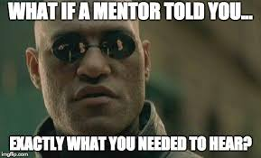
A little about Me…
British living in Denmark
Blogger
Senior Advisor
Open source
Teaching/Mentoring

Slide 3

Why do we do incident response?
Plainly we do it because we have to... The threat landscape dictates that every organization is at risk.
Center for Cyber Security threat landscape from 2020:-
Truslen fra cyberkriminalitet er MEGET HØJ. Truslen er rettet mod alle. Der er en stigende trussel fra målrettede ransomware-angreb mod danske myndigheder og virksomheder.
https://cfcs.dk/da/cybertruslen/trusselsvurderinger/cybertruslen-mod-danmark/

Slide 4
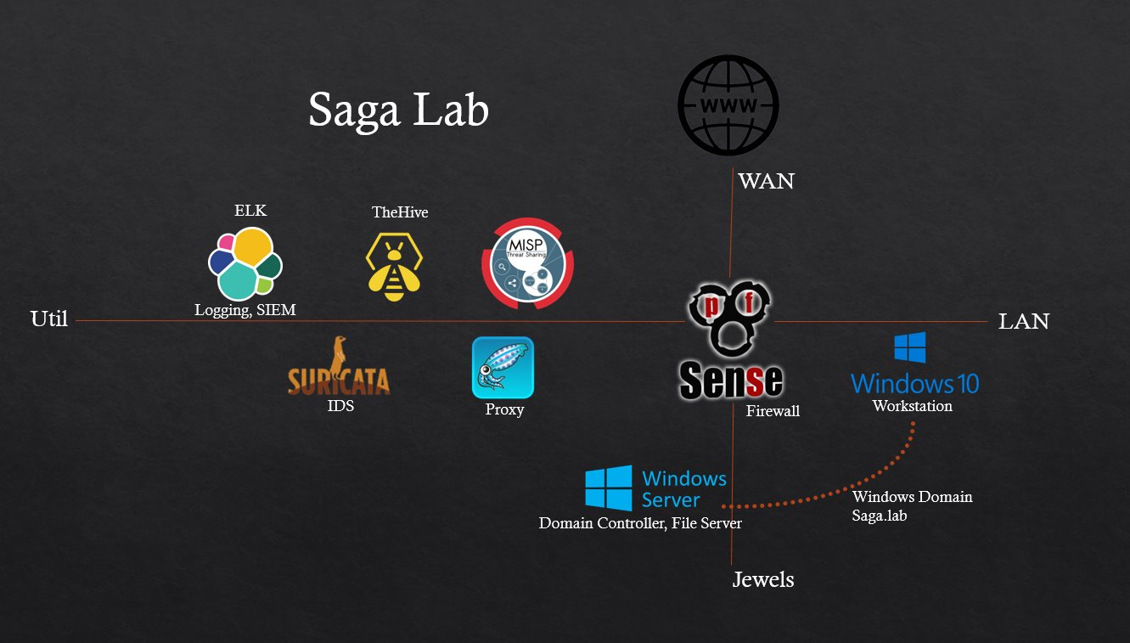


Slide 5
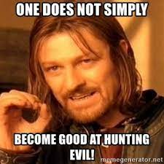
Hunting evil…

Slide 6
So it begins…
I got a call from the business academy in Aarhus…
A student had lost his internship and needed a new project
I had recently heard of a new concept for hunting for evil and I pitched the idea to him…
He said, this isn’t so interesting to him but that he would take a think about it and come back to me.
That night I got a long list of messages from the student…
“This idea is awesome, I have already started coding part of the project”

Slide 7
The hunt
For the next few weeks, I would regularly receive updates about the project…
What was the project?
Scanning the entire Danish IP address space looking for replies
Taking the replies and making some very specific requests to the IP addresses (JARM)
Storing this data in a database for further hunting
Each time I spoke to the student I would excitingly ask for the data he had so far…
Then one night…

Slide 8


Slide 9
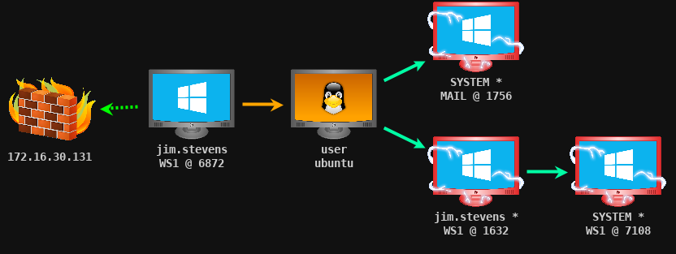
Finding evil
I received a huge excel spreadsheet of results from the entire Danish IP range…
With this data I could then begin to look for very specific patterns
Hunting for well known offensive tool servers
Cobalt Strike:- Used by Red Teams but also by real attackers
I filtered the data and found a few false positives… Then…
BINGO!
We had a hit for a very large Danish catering company
After further assessment it was confirmed that they were compromised
So what now?

Slide 10
Anyone know?

Slide 11

Contacting Cfcs
At this point I was working in the Danish finance industry, I did not feel comfortable taking further action as it was outside my jurisdiction…
So who should I contact?
I reached out to the Danish Center for Cyber Security
I called the situation center and then sent a follow up email
After a period of time the company fixed the issue…

Slide 12
Sometimes we don’t find evil…
Off the back of this project, we also found a few other things we believed were evil…
I took contact to someone who appeared to be hosting another well known attacker framework
It backfired a little bit…
David Thejl-Clayton 10:32 AM
Hi! Thanks for adding me, a very random question....
I am working on a project with the business academy in Aarhus and it consists of scanning the DK ip range looking for JARM hashes on https connections...
Could I be correct to find that you are running a metasploit server at home?
If so, this is just to confirm that our scanning is actually working...
Obfuscated Name 10:43 AM
Hi, Under no circumstances will I answer a question like this

Slide 13
But what is a threat?
Can you define what a threat is?

Slide 14
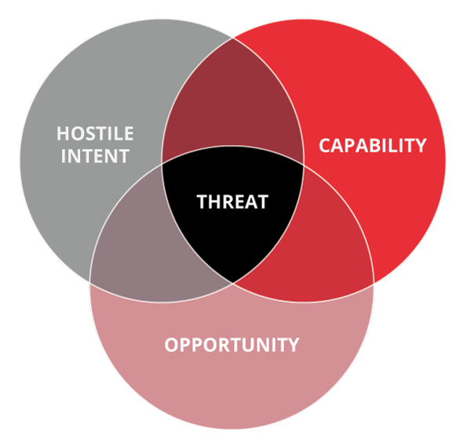
But what is a threat?
Intent: Do they have reasons to target you? Competitor?
Capability: Do they have the tooling and skills to carry it through?
Opportunity: Will they get the opening they need?

Slide 15
Where is the value in incident response?
Depending on who you ask, you will get a difference answer:-
CISO’s – Learning from our incidents, to make improvements to prevent the same mistake twice
CIO’s – Ensuring that operations aren’t impacted for too long in case of an incident
Incident Responders – Doing cool analysis and getting to be a hero
If only there was a magical way to unite all of the parties, and provide value to all of them…

Slide 16
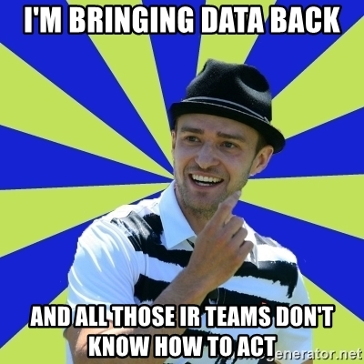
Data data data data
What if there was a way to satisfy all of the stakeholders needs…
Data is super important in incident response, and we will find out as we move through this case…

Slide 17
Exercise 1 – Security Incident
Do you know the difference between an event, security event and security incident?
Spend 10 minutes in your groups discussing each one, and write down your results in your Teams channel.
What is an event?
What is a security event?
What is a security incident?
An example: How do you classify a failed SSH login to a server in the logs?

Slide 18
Exercise 1 – Security Incident
What is an event? – An event is something that has happened and is observable.
What is a security event? – An event which is relevant to security and warrants investigation
What is a security incident? – A security event which has had an impact

Slide 19
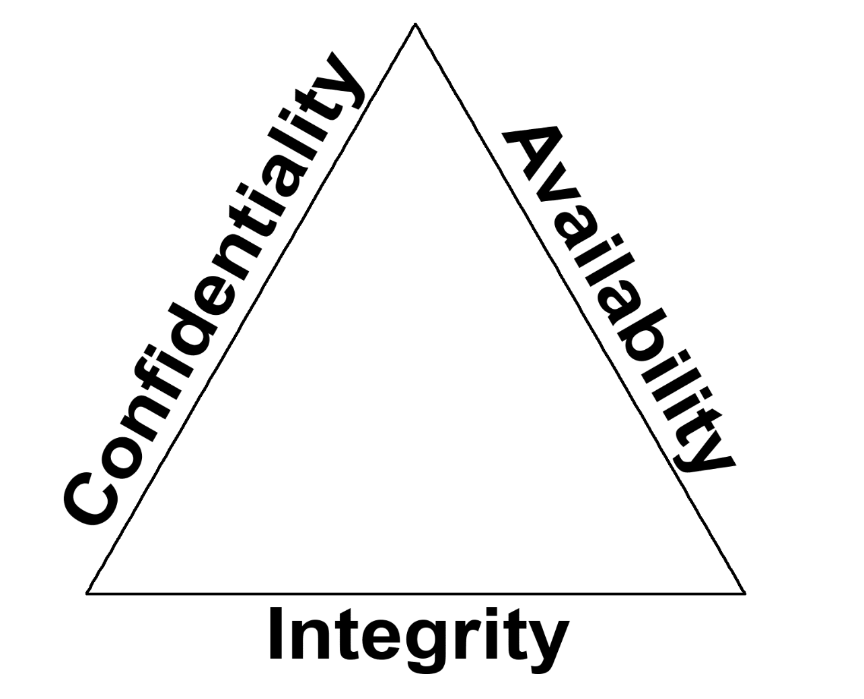
Impact
Confidentiality – Has data been compromised/leaked from the organization?
Availablity? – Has this incident resulted in downtime to a host/application/service?
Integrity – Has the integrity of the data/host/application/service been affected? Has data been manipulated?

Slide 20
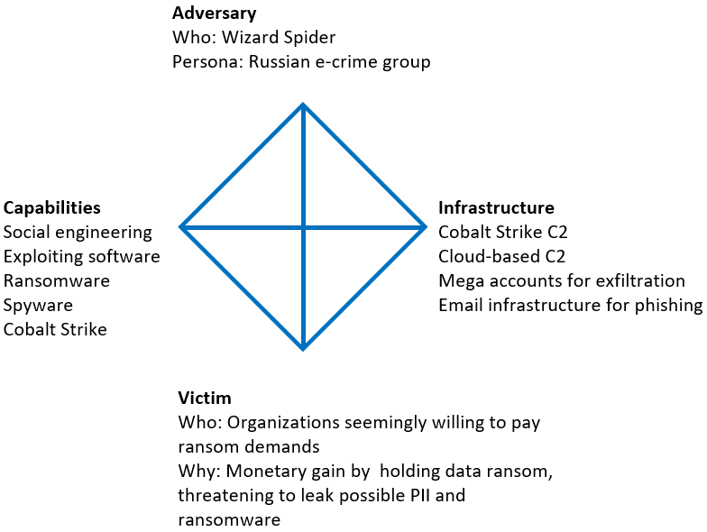

Slide 22
Solar winds…
An NDA prevents me talking fully about this case based on my previous employer.
But I was invited to assist a number of other companies which I can talk about…

Slide 23
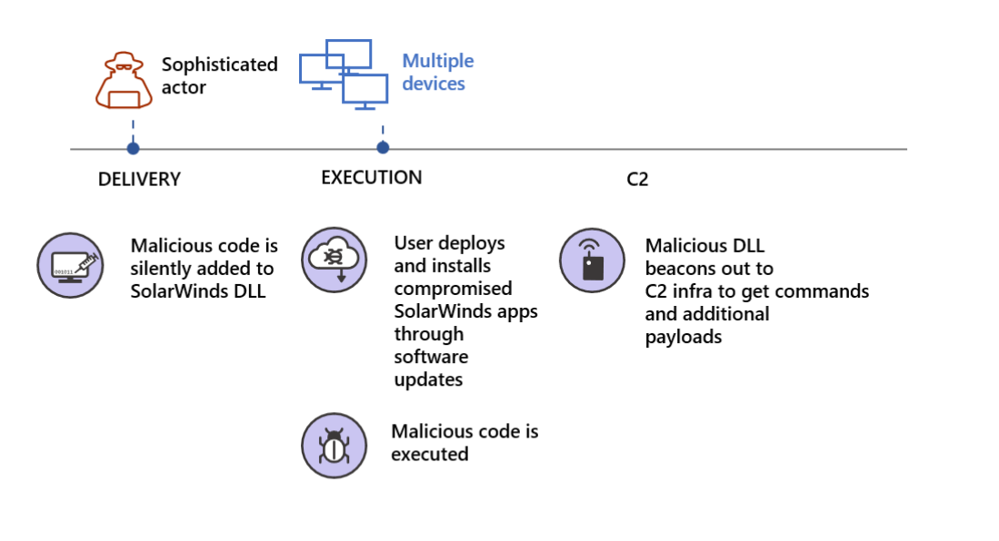
The attack…

Slide 24
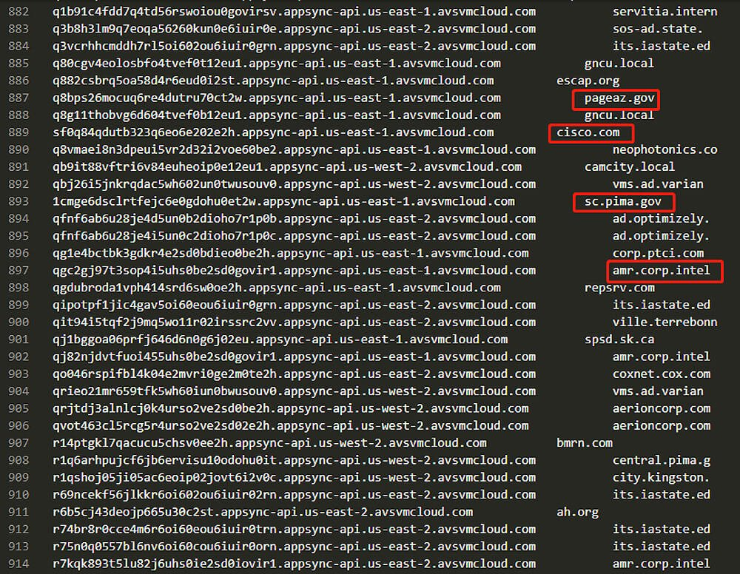
The list
A list was published of companies which had been hit by the 1st stage
The problem for a lot of companies was:-
If I am on the list what does it mean?
Have I been hacked?
Should I be worried?
What should we do about the press snooping around?
https://github.com/eaaa-it-security/CyberRange/blob/main/dgadeoded.txt

Slide 25
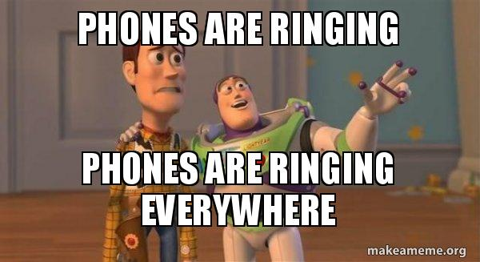
Then my phone rang… A lot…
I was called by a number of friends working in different organizations around Denmark.
My answers?
Just because you are on the list doesn’t mean you have been hacked
You shouldn’t be worried, but you should check for the following things…
I helped prepare press statements for them just in case

Slide 26
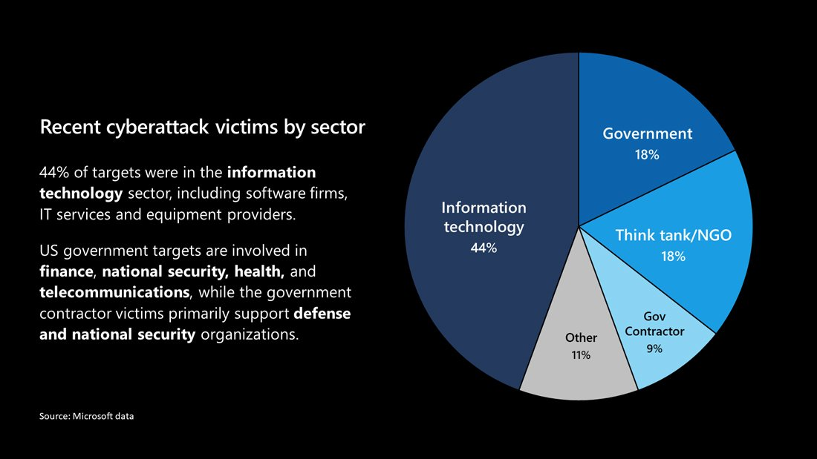
The result

Slide 27
Now we can finally look at our incident response process!

Slide 28
Incident Response Process 101
Stage 1
Alert
Stage 2
Visitation
Stage 3
Analysis
Stage 4
Response
Stage 5
Reporting
Acknowledge
RFI
Response actions
Communication

Slide 29

RE&CT Framework
Created by the awesome guys at Atomic Threat Coverage
Similar to the MITRE ATT&CK Framework
Incident Response contains repeatable actions
Document them
Heatmap them
Find gaps and improve
https://github.com/atc-project/atc-react

Slide 30
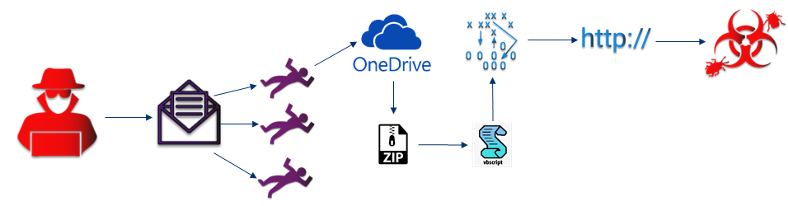
Qbot Infection
David Thejl-Clayton from the finance department recieves a mail reply as part of a previous mail correspondance with a friend.
The new reply has a OneDrive link inside, they click on the link which retrieves a ZIP file to their machine, helpguide.zip.
They unzip the file and it contains a file with a double extension, helpguide.docx.vbs. The file is shown by Windows to be a docx, so the user opens the file.

Slide 31
Qbot Infection
The file was actually a VBS script, which when executed retrieved some information from WMI about the OS version, AV engine etc.
It then attempted to retrieve, via BITS, second stage malware from a domain, which failed due to intelligence in the proxy filter.
The domain was totallylegit[.]dk.

Slide 32
Stage 1 - Alert
Nearly all incidents begin with an alert that something has happened that requires further investigation.
I say nearly all, because an incident can be started via the output from a threat hunt, or via a user reporting a suspicious email into the SOC.
In this case the alert came from the corporate proxy server intelligence feed which processes HTTP logs and looked like this…
The user DTC on hostname secdis01 has communicated with a known C2 hosting malicious domain.
Time: 15/03/2021 15:54 UTC
Username: DTC
Hostname: secdis01
Domain: totallylegit.dk
Domain Category: malicious
User-Agent: BitsAdmin

Slide 33
Communication
At this stage, who do you think we should be communicating with and why?

Slide 34
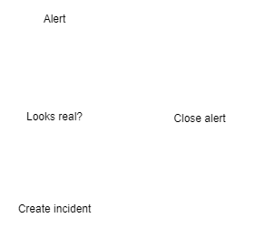
Stage 2 - Visitation
The reality is that analysis takes time and costs the business money to perform, alerting tools and detection engines like SIEM are also not always delivering true positive alerts.
This stage is for making decisions about:-
Does this alert need analysis?
Do I need more info? (user reported)
How should this alert be prioritised?
How should this alert be classified?

Slide 35
Stage 2 - Question
The user DTC on hostname secdis01 has communicated with a known C2 hosting malicious domain.
Time: 15/03/2021 15:54 UTC
Username: DTC
Hostname: secdis01
Domain: totallylegit.dk
Domain Category: malicious
User-Agent: BitsAdmin
Can anyone suggest any reasons why this alert might be false positive?

Slide 36
Stage 2 – FP or not
Things to consider:-
Quality of alert source?
Data available inside alert?
In this example it is only based on the domain name, what if this was a CDN or filesharing domain used for legitimate reasons too. This alert is also based on the vendors own intelligence feed, which could be out of date or also prone to FP.

Slide 37
That niggling feeling…

Slide 38
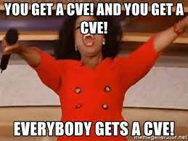
CVE-2019–19781
Firstly does everyone know what a CVE is?
Common Vulnerabilities and Exposures…
Easy right?
A CVE is assigned when a vulnerability is found within a system or service.
Central register for recording all CVE’s
Back to the story…
Hackers found a way to exploit a widely utilized platform called “Citrix”, they were able to achieve RCE and have that system carry out commands.
RCE (Remote code execution)

Slide 39
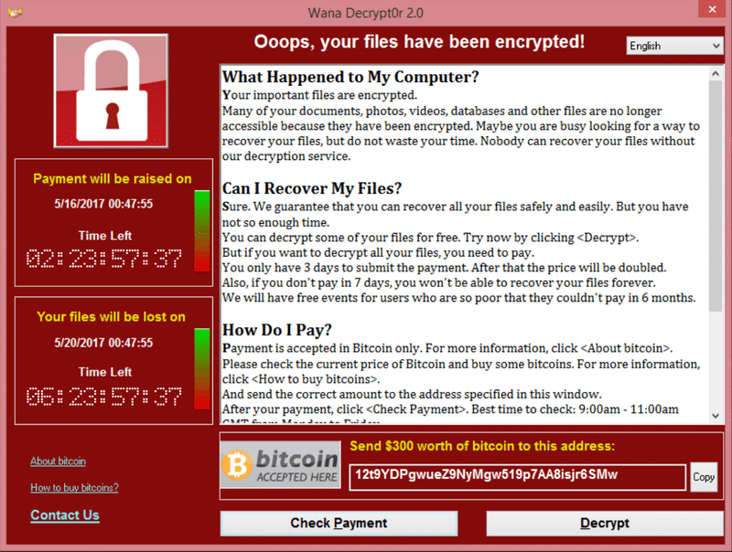
POC ----- Ransomware
POC stands for proof of concept, in this context a POC for the working exploit was released.
After a POC is released it doesn’t take long before attackers modify the POC and turn it into a fully working exploit.
Not long after the POC came out, the internet on January 11th 2020 witnessed large scale scanning by a number of attackers.

Slide 40
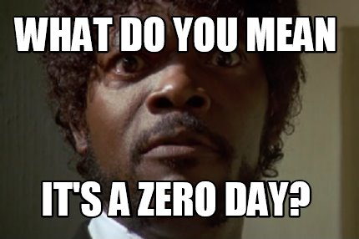
No patch
At the time the vulnerability was found, there was no patch. But systems could be protected by applying a workaround.
The company I worked with on this case applied the workaround to approximately 100+ Citrix servers all on the same day.
But…
It was a Friday night when I read about the widespread scanning…
I went to bed and when I woke up, I had a feeling something wasn’t right…

Slide 41
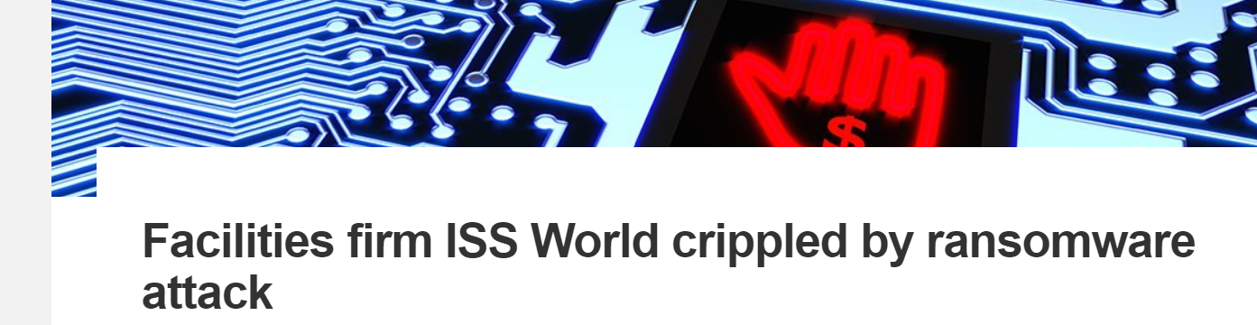
The one that got away…
It turns out that one Citrix server failed to update with the workaround
The server was exploited more than 20 times by various attackers
Luckily the server was placed in an isolated network and was not able to be used as a leapfrog into the organization.
Others were not so lucky…

Slide 42
Stage 2 – Decision Point
In this case, we have a user visiting a known malicious domain, especially with its relation to a known C2. We must analyze this alert further…
How should we prioritise it?
How should we classify it?
VERIS
ENISA

Slide 43
Stage 2 – Data data data
The user DTC on hostname secdis01 has communicated with a known C2 hosting malicious domain.
Time: 15/03/2021 15:54 UTC
Username: DTC
Hostname: secdis01
Domain: totallylegit.dk
Domain Category: malicious
User-Agent: BitsAdmin
time | 15/03/2021 15:54 UTC
hostname | secdis01
username | DTC
alert source | Proxy Server Logs
IOC.domain | totallylegit[.]dk
User Agent | BitsAdmin
Notes | Malicious domain visited

Slide 44
Bitsadmin
Does anyone know what Bitadmin is?
Windows Background Intelligent Transfer Service (BITS) is a low-bandwidth, asynchronous file transfer mechanism exposed through Component Object Model (COM). BITS is commonly used by updaters, messengers, and other applications preferred to operate in the background (using available idle bandwidth) without interrupting other networked applications.
https://attack.mitre.org/techniques/T1197/

Slide 45
Exercise 2 - How do we proceed?
We potentially have a host communicating to a C2 means that an attacker has got quite far in their attack.
It is our job as an incident responder to understand where should we start looking for clues/evidence to retrace the steps to find the initial infection vector.
Questions help drive the process, because they allow us to begin to come up with a plan to answer them…
In your groups again, can you come up with some questions to help us proceed?
An example question could be, is this a security incident?

Slide 46
How do we proceed?
Some questions in this incident could be:-
Is the host showing signs of C2 or is this a false positive?
Is it only one user who is infected?
How did this user get infected?
Is this a security incident?

Slide 47
Communication
At this stage, who do you think we should be communicating with and why?

Slide 48
Stage 3 - Analysis
Analysis is split up into 3 main parts:-
Collecting artifacts – Retrieving malicious files
Recording data – Which hosts were hit?
Analyzing data/artifacts – Analyzing the recorded data, and analyzing the malicious files

Slide 49
Stage 3 – Analysis
Analysis is quite self explanatory...
You analyze:-
Artifacts/evidence you collected
Logs and event data you may have collected before the incident
Analysis also leads to the need for further collecting and recording, the process is cyclic.
Collecting
Record
Analysis

Slide 50
Important Points
Lets take a quick look at RE&CT and ensure we are prepared for the incident…
What don’t we have available to use…
None of the items in yellow
No host, firewall, AD (domain controller), IDS, AV logs

Slide 51
Stage 3 Exercise 1
In your groups, using the RE&CT framework and information from the previous slide spend 15 minutes discussing how you would answer these two questions…
Is the host showing signs of C2 or is this a false positive?
Is it only one user who is infected?
Hint: Use both the preparation and identification section…
2nd hint: Remember your alert source ;)
time | 15/03/2021 15:54 UTC
hostname | secdis01
username | DTC
alert source | Proxy Server Logs
IOC.domain | totallylegit[.]dk
User Agent | BitsAdmin
Notes | Malicious domain visited

Slide 52
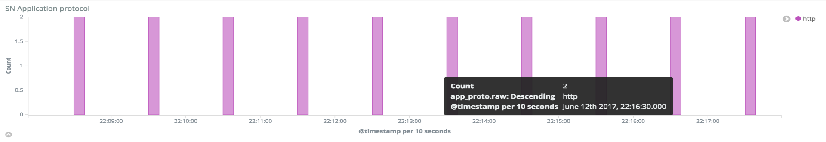
Stage 3 Exercise 1 Answers
Is the host showing signs of C2 or is this a false positive?
We know that we have access to HTTP logs and we know that the communication to the C2 is happening via HTTP as the alert came from the proxy server. So we could analyze these logs to look for telltale signs of C2 beaconing.
In this case no, there was no sign of C2, which is odd right? If the alert said so…
But it was confirmed to be BitsAdmin on the host calling out to the C2 domain.

Slide 53
Stage 3 Exercise 1 Answers
Is it only one user who is infected?
In this case you could analyze both DNS logs, or HTTP proxy logs to look for other hosts communicating with the C2 domain.
RA_2113_list_hosts_communicated_with_external_domain
In this case the answer was yes, it was only one host communicating with the external domain
Bonus question: Why might it not have been enough to rely solely on HTTP proxy logs?

Slide 54
But…
Can we for certain confirm that another user isn’t affected? If we are dealing with C2 traffic, what if there is another domain in use?
Finding out exactly how the user got infected, is key to being able to tell if another user is infected.
This is one of the pitfalls in incident response, we must take into account all possibilities..

Slide 55

MITRE ATT&CK Framework
Knowledge base of known attack vectors/patterns
Widely accepted as the industry standard for intrusion analysis
Maintained by the MITRE Corporation
How can we use MITRE ATT&CK to help us find the initial infection source?
Lets do this live on a MITRE ATT&CK layout…

Slide 56
MITRE ATT&CK - Exercise
Break up into your groups again, spend 10 minutes looking over the MITRE ATT&CK framework and discuss based on the current information we have about this alert:-
Are there any techniques or sub techniques that we can already say are being used?
If yes, which ones and why?
time | 15/03/2021 15:54 UTC
hostname | secdis01
username | DTC
alert source | Proxy Server Logs
IOC.domain | totallylegit[.]dk
User Agent | BitsAdmin
Notes | Malicious C2 domain visited
MITRE Techniques

Slide 57
MITRE ATT&CK – Exercise Answer
T1071 – Application Layer Protocol
T1102 – Web Service
T1197 – BITS Jobs
time | 15/03/2021 15:54 UTC
hostname | secdis01
username | DTC
alert source | Proxy Server Logs
IOC.domain | totallylegit[.]dk
User Agent | BitsAdmin
Notes | Malicious domain visited
MITRE Techniques | T1071, T1102, T1197

Slide 58
Where do we go from here?
We have 3 strong leads which we could begin investigating to get more concrete on answering our question.
Host – Should we do host forensics?
User – Should we ask the user for more information?
Domain – Should we analyze the domain further?
So what should we do??
time | 15/03/2021 15:54 UTC
hostname | secdis01
username | DTC
alert source | Proxy Server Logs
IOC.domain | totallylegit[.]dk
User Agent | BitsAdmin
Notes | Malicious domain visited
MITRE Techniques | T1071, T1102, T1197

Slide 59
Where do we go from here?
For me the fastest and simplest approach is to start with analyzing the domain…
Host - Forensics takes a lot of time and is based on a number of things being in our favour, do we have access to the machine physically? Or do we need to wait for it to be sent to our office… Where do we start looking on the host?
User – Can we trust the user to be a source of quality information?
Domain – Finding out more information about why our proxy intelligence feed has classified this domain as malicious is going to give us far more context to narrow our investigation.

Slide 60
CTI – Cyber Threat Intelligence
“Cyber Threat intelligence is data that is collected, processed, and analyzed to understand a threat actor’s motives, targets, and attack behaviors.
Cyber Threat intelligence enables us to make faster, more informed, data-backed security decisions and change their behavior from reactive to proactive in the fight against threat actors.”
https://www.crowdstrike.com/cybersecurity-101/threat-intelligence/

Slide 61
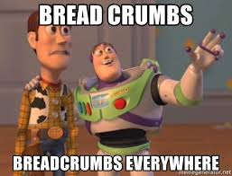

Slide 62
Domain - Analysis
Local CTI
Our local sharing partners, can confirm they have seen this domain used to host Qbot malware and they have seen a campaign from the sender: David@notmalicious.dk
But they are still doing their own investigation so couldn’t share anymore information.
Global CTI
Combining the information from our local CTI and the domain name, we can find that this is a very recent Qbot campaign…
Further research shows Qbot infection chain is:-
Spearphishing link via email to Onedrive, hosting .zip file. There is further mentioning of macros in office documents.

Slide 63
Data data data
Now we know the domain was also used for hosting the malware and not just for C2.
We can remove the Command and Control MITRE techniques.
But we can add some new ones in:-
T1566 – Phishing
T1204 – User execution
T1197 - BitsAdmin
time | 15/03/2021 15:54 UTC
hostname | secdis01
username | DTC
alert source | Proxy Server Logs
IOC.domain | totallylegit[.]dk
User Agent | BitsAdmin
Notes | Malicious domain visited
MITRE Techniques | T1566, T1204, T1197
Email sender | David@notmalicious.dk

Slide 64
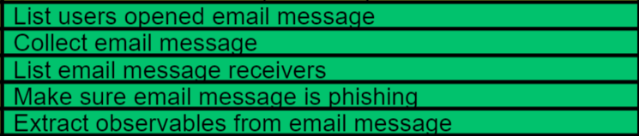
Email - Analysis
RE&CT can help here…
We can list email message receivers and use the sender as our filter on the mail server.
List mails received from specific sender:-
David@notmalicious.dk
BINGO!
Subject: How is the weather?
Now we can run through the RE&CT identification actions…
List email message recievers
List users opened email message
Collect email message
Extract observables from email message

Slide 65
Wait what? Email subject is “How is the weather?”

Slide 66
The trusted relationship

Slide 67
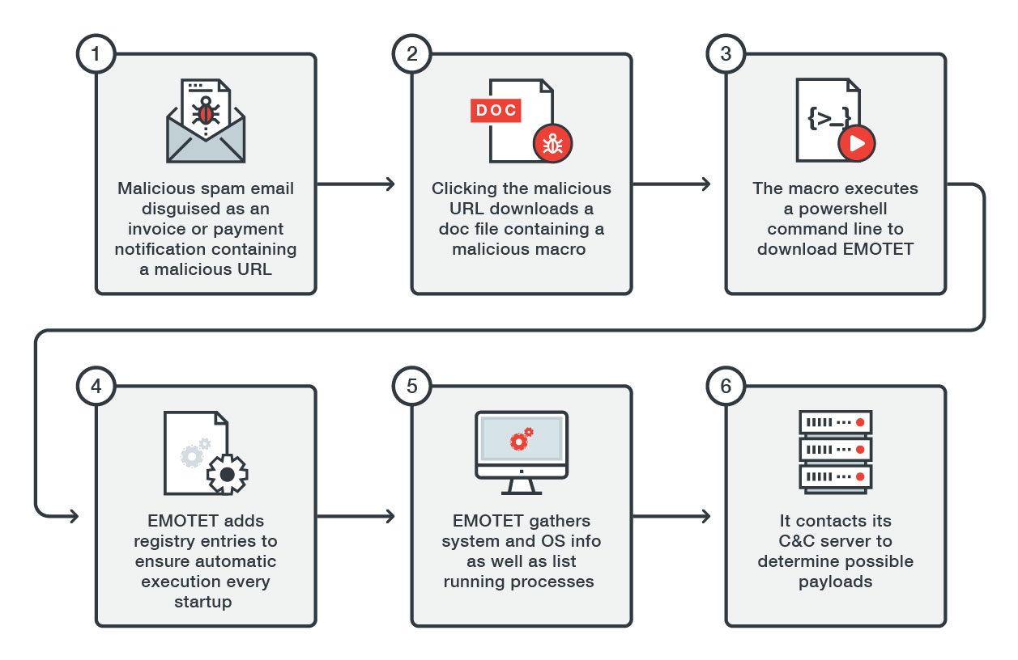
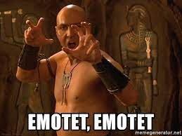
Emotet

Slide 68
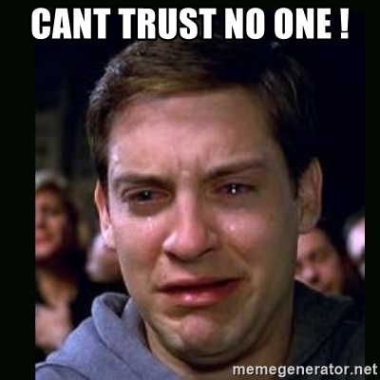
Why do users fall for this?
The key is to first understand where is the malicious mail coming from?
When Emotet compromised a user it propagated by specifically looking in the users email for any words related to finance
Now lets imagine something…
You have an ongoing dialogue with your banking advisor
Hi bank, I would like to purchase this car
Ok please send across your budget so I can see if we can allocate the loan
Please find the document attached to this OneDrive link

Slide 69
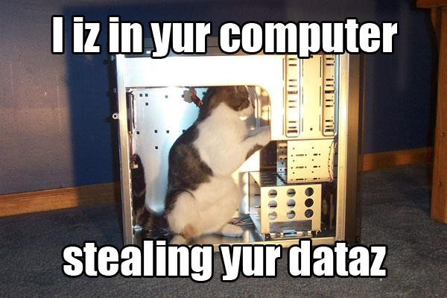
Did you see it?
Hi bank, I would like to purchase this car
Ok please send across your budget so I can see if we can allocate the loan
Please find the document attached to this OneDrive link
This type of compromise is very hard to spot as it relies on what we call a “Trusted Relationship” to social engineer the user
The user won’t even know that they have been compromised

Slide 70
Email - Analysis
After retrieving the email we can find the Onedrive link…
We also find that the email was an email thread hijack, which could explain why our user fell for the phishing attack.
Following the Onedrive link we are able to retrieve the helpguide.zip file.
Hi David,
Hope the weather in England is nice. Regards, Andrew
------
Hi Andrew,
Weather is great thanks, Regards, David
------
David find attached the file you asked me for recently: onedrive.com/helpguide.zip

Slide 71
Data data data
time | 15/03/2021 15:54 UTC
hostname | secdis01
username | DTC
alert source | Proxy Server Logs
IOC.domain | totallylegit[.]dk
User Agent | BitsAdmin
IOC.url | onedrive[.]com/helpguide.zip
Notes | Malicious domain visited
MITRE Techniques | T1566, T1204, T1197
Email sender | David@notmalicious.dk
Email subject | How is the weather
IOC.filename | helpguide.zip

Slide 72
File - Analysis
Now that we have the file which seems to have caused all of the trouble, we need to analyze it to look for evidence of what it was doing on the host, also to find possible backup malware hosting domains or C2 domains.
Unzipping the file results in us finding a visual basic script masquerading as a docx.
helpguide.docx.vbs
Dynamic Analysis – Sandboxing
Static Analysis – Reverse Engineering
In this case which makes the most sense?
Use static analysis to check for obfuscation, if none then continue.
Else use Dynamic…

Slide 73
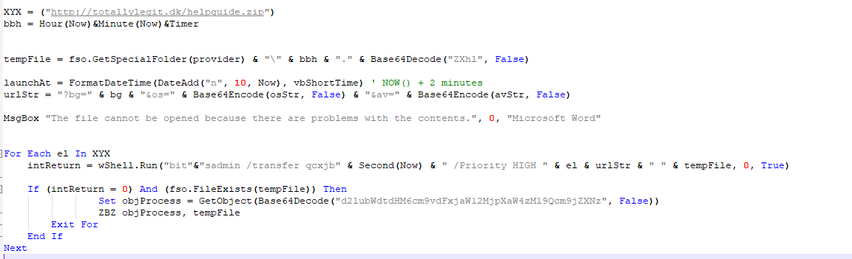
File - Static Analysis
The code is not obfuscated and is incredibly simple.
Makes some queries to WMI to ask for OS version, AV vendor and a few other parameters.
Then uses these to request the relevant payload from totallylegit[.]dk

Slide 74
Interesting decision point…
Now we have the 2nd stage payload url, we could retrieve the malware and begin analysis to look for more interesting evidence…
But…
We know that the communication to the payload hosting domain was blocked by the proxy server, and we do not have any further domains to worry about…
What would you do?

Slide 75
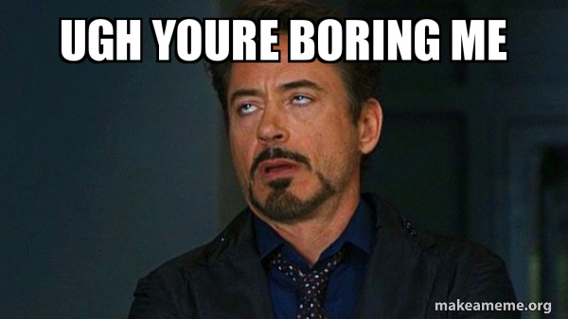
My decision…
Based on all the factors, and that we know this is a more generic malware family campaign.
I would choose to retrieve the malware, but not perform analysis as part of this incident. As written earlier, incident response requires fast action and is also expensive.
We need to make the differentiation between need to have and nice to have.
Further analysis within the incident would only impede the speed to response, and therefore should be left till after the incident is closed.

Slide 76
Data data data
time | 15/03/2021 15:54 UTC
hostname | secdis01
username | DTC
alert source | Proxy Server Logs
IOC.domain | totallylegit[.]dk
User Agent | BitsAdmin
IOC.url | onedrive[.]com/helpguide.zip
Classification | Malware, Social Engineering
MITRE Techniques | T1566, T1204, T1197
Email sender | David@notmalicious.dk
Email subject | How is the weather
IOC.filename | helpguide.zip
IOC.hash.md5 | 63a5f69f39278ec080b94314a6e2df94
IOC.filename | helpguide.docx.vbs
IOC.hash.md5 | 721fa9844433102021aa0f693efa8468
You will notice that after performing static analysis we were able to update the data table with hash values for the files we were working with…
The notes section has been removed and replaced with the classification section. This is highly relevant for Stage 5, which we will come to later…

Slide 77
What next?
Have we answered our questions from earlier?
Is the host showing signs of C2 or is this a false positive? No
Is it only one user who is infected? Yes now we know it was only one domain
How did this user get infected? Via email
With all of the data collected, and knowing that the malware was not successful at retrieving 2nd stage, lets close down our analysis and move to response!

Slide 78
Communication
At this stage, who do you think we should be communicating with and why?

Slide 79
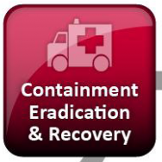
Stage 4
It is funny that the actual response within incident response actually comes quite late in the process.
Response is split into a few parts:-
Containment – Stopping and preventing further compromise
Eradication – Removing the malicous artifacts to prevent future compromise
Recovery – Bringing the host or organization back to the previous state before the incident
Stage 4
Response

Slide 80
Stage 4 – Quick note
Just because the process is set in “stages” does not mean that you have to wait until you have gathered all evidence before you can begin containment.
In some cases it is very useful to lockout a user, or isolate a host whilst running an investigation.
Stage 3
Analysis
Stage 4
Response

Slide 81
Stage 4 - Exercise
In your groups, spend 15 minutes using the data table from the Analysis round.
From this data, decide which artifacts might warrant earlier containment than others and why?
Then discuss which actions from the RE&CT framework you would use and why?
Bonus – Can you also describe which actions might have a larger impact to the business and why?

Slide 82
Stage 4 - Exercise
time | 15/03/2021 15:54 UTC | Actions
hostname | secdis01
username | DTC
alert source | Proxy Server Logs
IOC.domain | totallylegit[.]dk
User Agent | BitsAdmin
IOC.url | onedrive[.]com/helpguide.zip
Classification | Malware, Social Engineering
MITRE Techniques | T1566, T1204, T1197
Email sender | David@notmalicious.dk
Email subject | How is the weather
IOC.filename | helpguide.zip
IOC.hash.md5 | 63a5f69f39278ec080b94314a6e2df94
IOC.filename | helpguide.docx.vbs
IOC.hash.md5 | 721fa9844433102021aa0f693efa8468

Slide 83
Communication
At this stage, who do you think we should be communicating with and why?

Slide 84
Stage 5
For an organization, Stage 5 is where the real value from incident response is driven…
In Stage 4 the focus is on bringing the organization back to the state they were in before the incident happened. But in Stage 5 you have the chance to make a difference and improve things for the future.
This is done via:-
Incident response reporting
Lessons learned
Long term IR reporting data collection

Slide 85
Where should we concentrate our user awareness training this year?
(Governance team)

Slide 86
Stage 5 - Exercise
In your groups, create a basic incident response report on the data that has been collected in this case.
The incident response report must contain:-
Executive summary
Results of analysis
Actions which were performed
Recommendations for recovery
Recommendations for future prevention

Slide 87


combitech.se | .fi | .dk | .com
watchcom.no

